Slide 1
SOLVING PROBLEMS BY SEARCHING
Dr. Noman Islam

Slide 2
Introduction
Uninformed Vs informed searches
Goals help organize behavior by limiting the objectives that the agent is trying to achieve and hence the actions it needs to consider.
Goal formulation, based on the current situation and the agent's performance measure, is the first step in problem solving.
We will consider a goal to be a set of world states—exactly those states in which the goal is satisfied.
The agent's task is to find out how to act, now and in the future, so that it reaches a goal state.

Slide 3
Problem formulation is the process of deciding what actions and states to consider, given a goal.
The process of looking for a sequence of actions that reaches the goal is called search.
A search algorithm takes a problem as input and returns a solution in the form of an action sequence.
Once a solution is found, the actions it recommends can be carried out. This is called the execution phase.

Slide 4
While the agent is executing the solution sequence it ignores its percepts when choosing an action because it knows in advance what they will be.
An agent that carries out its plans with its eyes closed, so to speak. must be quite certain of what is going. Control theorists call this an open-loop system

Slide 5
Problem
A problem can be defined formally by five components:
The initial state that the agent starts in
A description of the possible actions available to the agent Given a particular state s, ACTIONS(s) returns the set of actions that can be executed in s. We say that each of these actions is applicable in s.
A description of what each action does; the formal name for this is the transition model, specified by a function REsuur(s, a) that returns the state that results from doing action a in state s. We also use the term successor to refer to any state reachable from a given state by a single action.

Slide 6
Together, the initial state, actions, and transition model implicitly define the state space of the problem—the set of all states reachable from the initial state by any sequence of actions
A path in the slate space is a sequence of states connected by a sequence of actions
The goal test, which determines whether a given state is a goal state.
A path cost function that assigns a numeric cost to each path.
The problem-solving agent chooses a cost function that reflects its own performance measure.
The step cost of taking action a in state s to reach state s' is denoted by c(s,a, s').

Slide 7
A solution to a problem is an action sequence that leads from the initial state to a goal state. Solution quality is measured by the path cost function, and an optimal solution has the lowest path cost among all solutions.

Slide 8
Example problems
A toy problem is intended to illustrate or exercise various problem-solving methods.
A real-world problem is one whose solutions people actually care about. Such problems tend not to have a single agreed-upon description, but we can give the general flavor of their formulations.

Slide 9
Vacuum cleaner problem
States: The state is determined by both the agent location and the dirt locations. The agent is in one of two locations, each of which might or might not contain dirt. Thus, there are 2 x 2² = B possible world states. A larger environment with n locations has n • 2^{n} states.
Initial state: Any state can be designated as the initial state.
Actions: In this simple environment, each state has just three actions: Left, Right, and Suck. Larger environments might also include Up and Down.
Transition model: The actions have their expected effects, except that moving Left in the leftmost square, moving Right in the rightmost square, and Sucking in a clean square have no effect. The complete state space is shown in Figure 3.3.
Goal test: This checks whether all the squares are clean.
Path cost: Each step costs 1, so the path cost is the number of steps in the path.

Slide 10
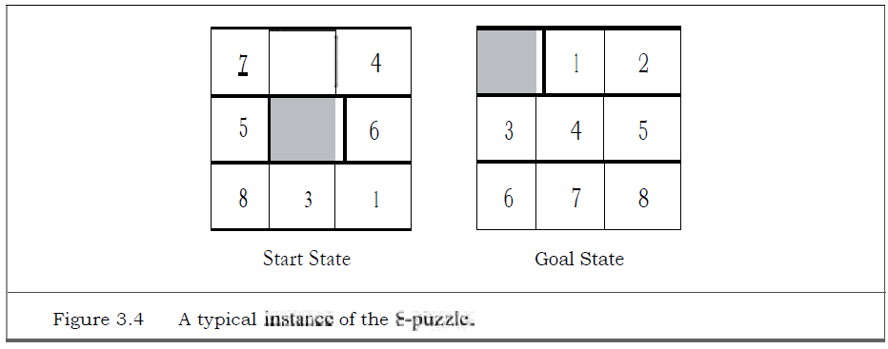

Slide 11
8-puzzle problem
States: A state description specifies the location of each of the eight Ides and the blank in one of the nine squares.
Initial state: Any state can be designated as the initial state. Note that any given goal can he reached Front exactly half of the possible initial states
Actions: The simplest formulation defines the actions as movements of the blank space Left, Right, Up, or Down. Different subsets of these are possible depending on where the blank is.
Transition model: Given a state and action, this returns the resulting state; for example, if we apply Left to the start state in Figure 3.4, the resulting state has the 5 and the blank switched.
Goal test: This checks whether the state matches the goal configuration shown in Figure 3.4. (Other goal configurations are possible.)
Path cost: Each step costs 1, so the path cost is the number of steps in the path.

Slide 12
The 8-puzzle belongs to the family of sliding-block puzzles, which are often used as test problems for new search algorithms in AI. This family is known to be NP-complete, so one does not expect to find methods significantly better in the worst case than the search algorithms described in this chapter and the next. The 8-puzzle has 91/2 =181, 440 reachable states and is easily solved. The 15-puzzle (on a 4 x 4 board) has around 1.3 trillion states, and random instances can be solved optimally in a few milliseconds by the best search algorithms. The 24-puzzle (on a 5 x 5 board) has around 10²⁵ states, and random instances take several hours to solve optimally.

Slide 13
The goal of the 8-queens problem is to place eight queens on a chessboard such that no queen attacks any other. (A queen attacks any piece in the same row, column or diagonal.)
An incremental formulation involves operators that augment the state description, starting with an empty state; for the 8-queens problem, this means that each action adds a queen to the state
A complete-state formulation starts with all 8 queens on the board and moves them amend. In either case, the path cost is of no interest because only the final state counts.

Slide 14
States: Any arrangement of 0 to 8 queens on the board is a state.
Initial state: No queens on the board.
Actions: Add a queen to any empty square.
Transition model: Returns the board with a queen added to the specified square.
Goal test: 8 queens are on the board, none attacked.
In this formulation, we have 69 • 63 • • • 57 1.8 x 1014 possible sequences to investigate.

Slide 15
A better formulation
States: All possible arrangements of n queens (0 < rt < 8), one per column in the leftmost n. columns, with no queen attacking another.
Actions: Add a queen to any square in the leftmost empty column such that it is not attacked by any other queen.

Slide 16

Knuth conjectured that, starting with the number 4, a sequence of factorial, square root, and floor operations will reach any desired positive integer. For example, we can reach 5 from 4 as follows:

Slide 17
The problem definition is very simple:
States: Positive numbers.
Initial state: 4.
Actions: Apply factorial, square root, or floor operation (factorial for integers only).
Transition model: As given by the mathematical definitions of the operations.
Goal test: State is the desired positive integer.

Slide 18
Real world problems
Route-finding algorithms are used in a variety of applications. Some, such as Web sites and in-car systems that provide driving directions
routing video streams in computer networks, military operations planning, and airline travel-planning systems, involve much more complex specifications.

Slide 19
Air line travel problem
Consider the airline travel problems that must be solved by a travel-planning Web site:
States: Each state obviously includes a location (e.g., an airport) and the current time. Furthermore, because the cost of an action (a flight segment) may depend on previous segments, their fare bases, and their status as domestic or international, the state must record extra information about these "historical" aspects.
Initial state: This is specified by the user's query.
Actions: Take any flight from the current location, in any seat class, leaving after the current time, leaving enough time for within-airport transfer if needed.
Transition model: The state resulting from taking a flight will have the flight's desti-nation as the current location and the flight's arrival time as the current time.
Goal test: Are we at the final destination specified by the user?
Path cost: This depends on monetary cost, waiting time, flight time, customs and im-migration procedures, seat quality, time of day, type of airplane, frequent-flyer mileage awards, and so on.

Slide 20
Touring problems
The traveling salesperson problem (TSP) is a touring problem in which each city must be visited exactly once. The aim is to find the shortest tour. The problem is known to be NP-hard, but an enormous amount of effort has been expended to improve the capabilities of TSP algorithms.

Slide 21
A VLSI layout problem requires positioning millions of components and connections on a chip to minimize area, minimize circuit delays, minimize stray capacitances, and maximize manufacturing yield.
Robot navigation is a generalization of the route-finding problem described earlier.
Automatic assembly sequencing of complex objects by a robot
Another important assembly problem is protein design, in which the goal is to find a sequence of amino acids that will fold into a three-dimensional protein with the right properties to cure some disease

Slide 22
Measuring performance
Completeness: Is the algorithm guaranteed to find a solution when there is one?
Optimality: Does the strategy find the optimal solution?
Time complexity: How long does it take to find a solution?
Space complexity: How much memory is needed to perform the search?

Slide 23
Uninformed search strategies
The strategies have no additional information about states beyond that provided in the problem definition.
All they can do is generate successors and distinguish a goal state from a non-goal state.
Strategies that know whether one non-goal state is "mom promising" than another arc called informed search or heuristic search strategies

Slide 24
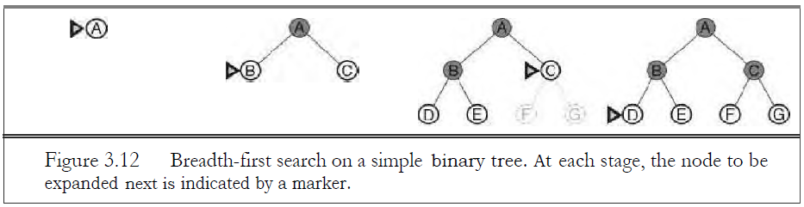
Breadth first search
Breadth-first search is a simple strategy in which the root node is expanded first, then all the successors of the root node are expanded next, then their successors, and so on.

Slide 25
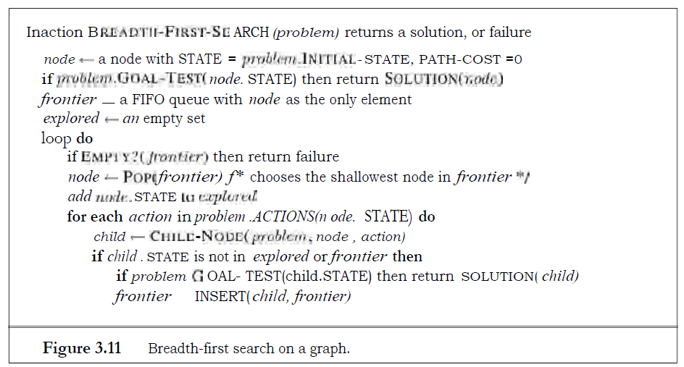

Slide 26
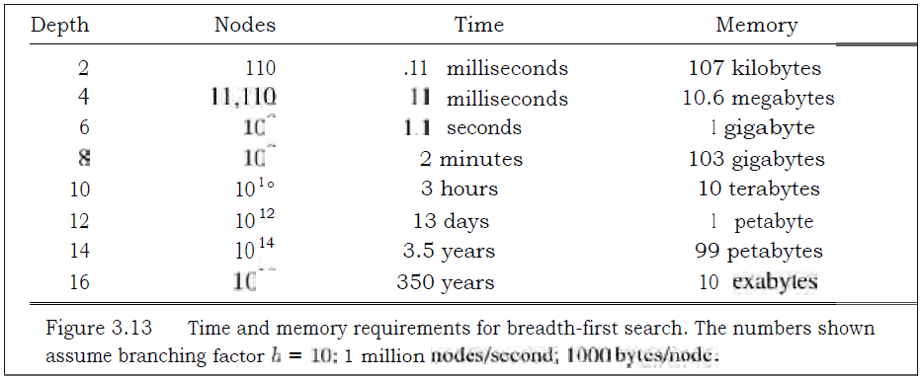

Slide 27
Uniform Cost Search
When all step costs are equal, breadth-first search is optimal because it always expands the shallowest unexpanded node.
Instead of expanding the shallowest node, uniform-cost search expands the node n with the lowest path cost y(n). This is done by storing the frontier as a priority queue ordered by q.

Slide 28
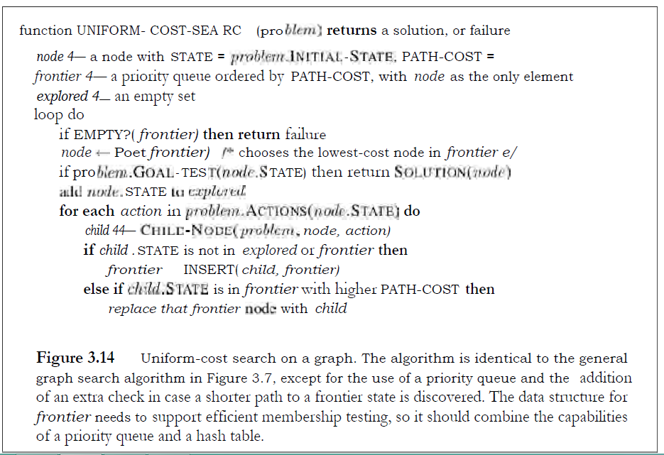

Slide 29
Depth First Search
Depth-first search always expands the deepest node in the current frontier of the search tree. The search proceeds immediately to the deepest level of the search tree, where the nodes have no successors. As those nodes are expanded, they are dropped from the frontier, so then the search "backs up" to the next deepest node that still has unexplored successors.
Depth-first search uses a LIFO queue. A LIFO queue means that the most recently generated node is chosen for expansion. This must be the deepest unexpanded node because it is one deeper than its parent—which, in turn, was the deepest unexpanded node when it was selected

Slide 30
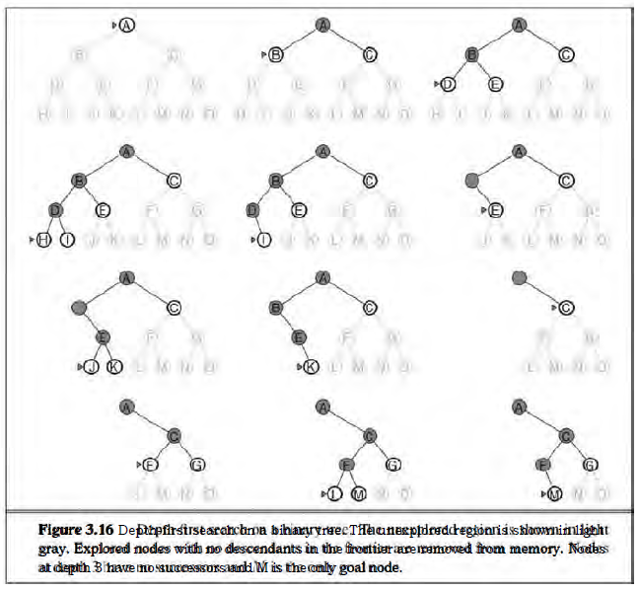

Slide 31
Depth limited search
The embarrassing failure of depth-first search in infinite state spaces can be alleviated by supplying depth-first search with a predetermined depth limit P. That is, nodes at depth E are treated as if they have no successors. This approach is called depth-limited search

Slide 32
Iterative deepening depth-first search
Iterative deepening search (or iterative deepening depth-first search) is a general strategy. often used in combination with depth-first tree search, that finds the best depth limit. It does this by gradually increasing the limit—first 0, then 1, then 2, and so on—until a goal is found. This will occur when the depth limit reaches d, the depth of the shallowest goal node.

Slide 33
Bi-directional search
The idea behind bidirectional search is to run two simultaneous searches—one forward from the initial state and the other backward from the goal—hoping that the two searches meet in the middle
Bidirectional search is implemented by replacing the goal test with a check to see whether the frontiers of the two searches intersect; if they do, a solution has been found.

